Slide 1
Low-Level Software Vulnerabilities
Oli Bills
ofb@ecs.soton.ac.uk

Slide 2
This Lecture
An introduction to low-level software vulnerabilities
What are they?
Why do they matter?
An introduction to low-level software
C
Assembly
Examples of low-level software vulnerabilities
Buffer overflow
Heap exploitation
Stack exploitation
Integer overflow
File and memory management
An introduction to the defenses

Slide 3
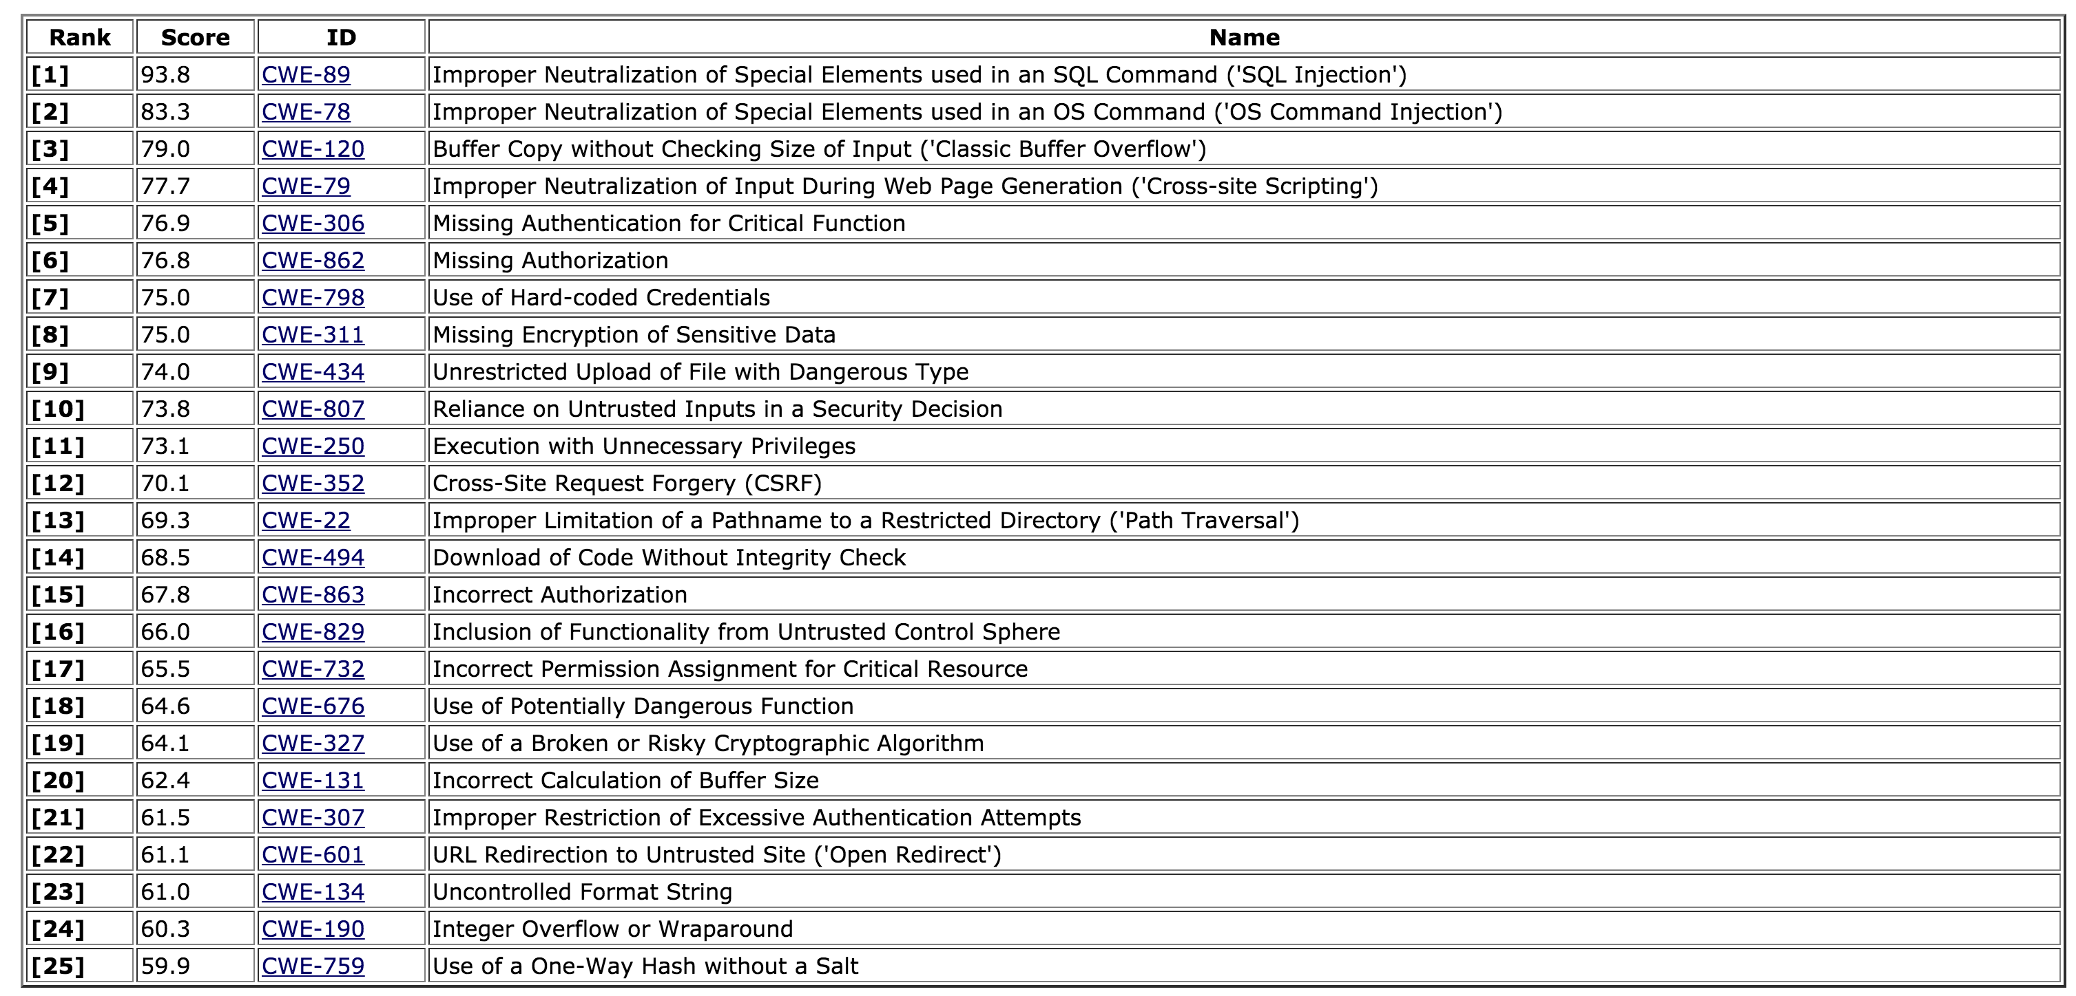
SANS Top 25 Most Dangerous Software Errors

Slide 4
SANS Top 25 Most Dangerous Software Errors

Slide 5
High-level Vulnerabilities
Many of these are higher level vulnerabilities
‘Security’
Authentication
Privilege Escalation
Inappropriate Authorisation
Access Control
Integrity

Slide 6
Low-level vulnerabilities
Going to be focusing on the lower-level vulnerabilities
‘Safety’
Buffer Overflow
Heap-based exploitation
Stack-based exploitation
Integer overflow
File management
Memory management

Slide 7
Why do they matter?
Languages such as C and C++ are still very popular
Many critical systems are written in them
Operating system kernels
Many operating system utilities
Including privileged applications, such as ‘sudo’
Servers
Embedded systems
Can you think of any examples?

Slide 8
Modern Languages
Modern languages bypass a lot of these low-level vulnerabilities
Execute in a controlled, managed environment
PHP, Java, Ruby, Python…
Although even then, they often use low-level libraries

Slide 9
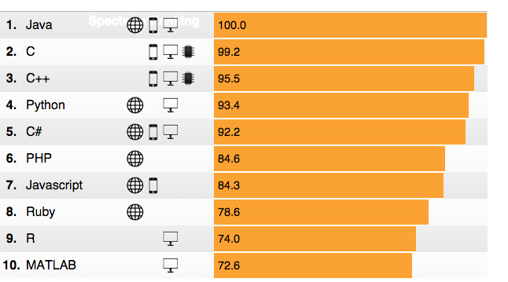
But... C and C++ are still very popular

Slide 10
How can you avoid them?
The golden design rules
Minimise security-sensitive code
Least privilege principle
Run with the least privileges possible
Revoke privileges when not needed
Ensure safe defaults
Deny by default
Limit resource consumption
Fail gracefully
Fail securely
Question your assumptions and decisions…

Slide 11
As always, it’s about the input!
It’s all about input
Where the user can put things in that they shouldn’t
How does your code handle invalid input?
Does your code handle invalid input?
Did you even consider invalid input!?
The key thing: Input is guilty until proven innocent

Slide 12
As always, it’s about the input!
Validate your input
Make sure you have ended up with what you expected before you go further
Deny by default, then allow if the input is what you expect
Validation
Type checking
Bounds checking
Length checking
Pattern checking

Slide 13
Let’s go back to the beginning…
Given so much is written in C
Let’s begin by looking at C
Compilers turn C code into machine code
We can view this as assembly, which is human readable
1:1 correspondence to machine code
Let’s us see what the code is actually doing
Particularly useful when we don’t have the source code
But it’s not easy!

Slide 14
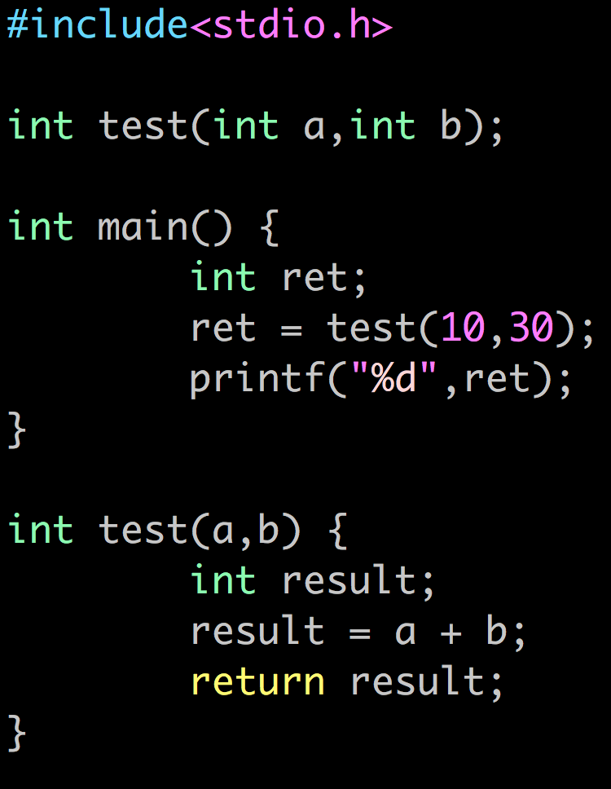
Here’s a simple C program
Can you work out what it does?

Slide 15
Here’s a simple C program
There is a function called test which adds two numbers together and returns them
The main function calls test with the 10 and 30 parameters
The program adds 10 and 30, gets the result, and then displays it

Slide 16
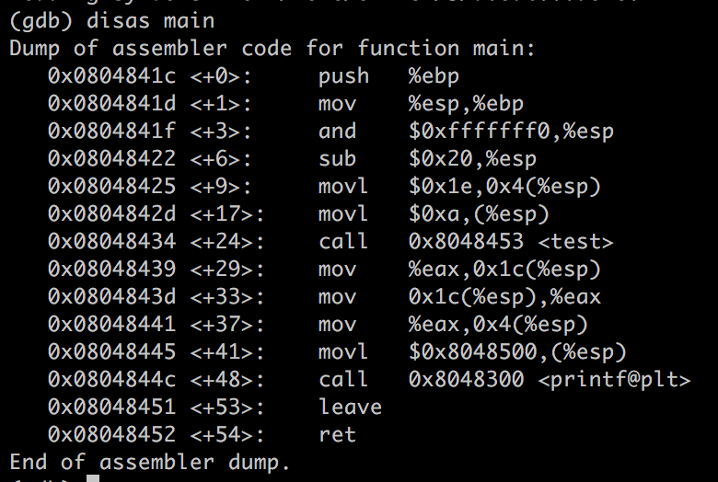
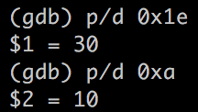
Let’s take a closer look inside
This is the assembler code for the main function
We can see it set up the two parameters and then call the test function
Remember, it’s in hex, but we can more convert it using the print command
It gets the result at the end and then calls printf to display it

Slide 17
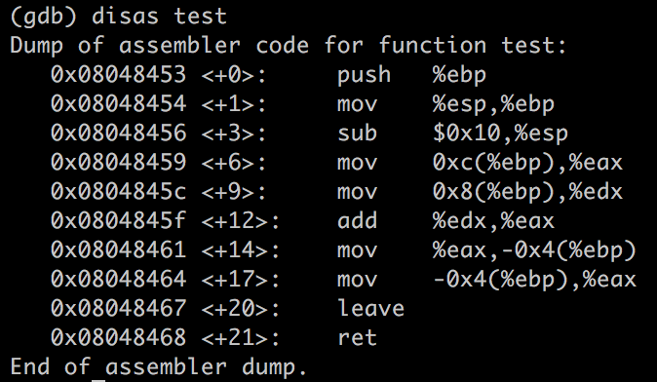
Let’s take a closer look inside
We can also look at the test function
It loads the values into eax and edx, then adds them
It then returns the result

Slide 18
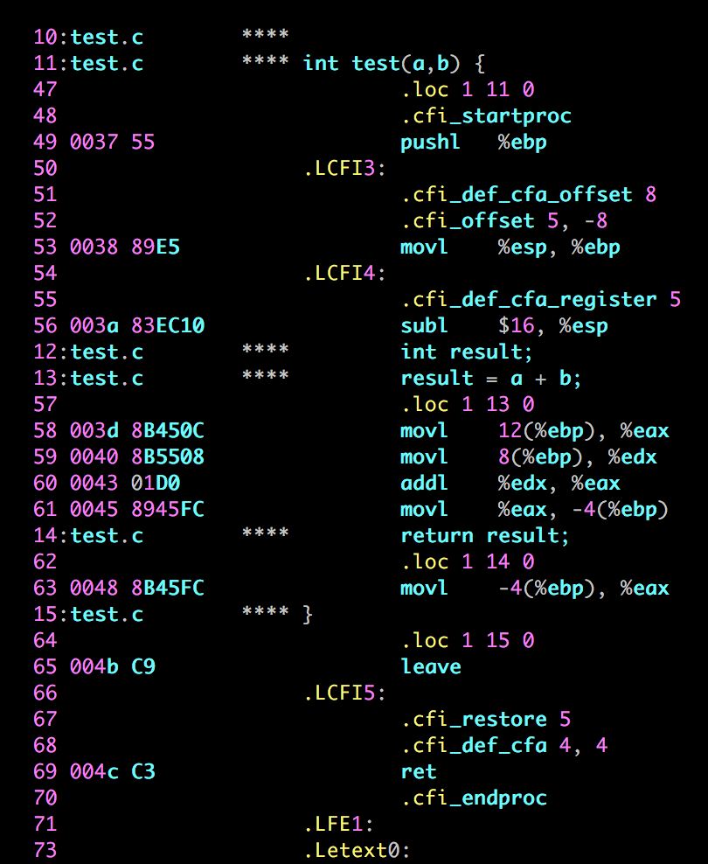
When you write your own C
You can tell GCC to show you the corresponding C code and generated assembly
gcc -c -g -Wa,-a,-ad file.c > file.lst

Slide 19
Registers
You’ll have noticed a set of registers – but what are they?
Caller saved: %eax, %ecx, %edx
You must save these before a function call if you need them
Callee saved: %ebx, %edi, %esi
You must save these before any work if you need them
Base pointer: %ebp
Points to the “bottom” of a stack frame
Stack pointer: %esp
Points to the “top” of a stack frame
Instruction pointer: %eip
Generally don’t need to worry about this one

Slide 20
Memory organisation
Stack
LIFO structure
Stack frames
Heap
Dynamic memory allocation
malloc/realloc/free
BSS
Unitialised data
int j;
Data
Initialised data
int i = 3;
Text
Code segment

Slide 21
Stack frames
Carnegie Mellon
Every function call is given a stack frame
What does a C function need?
Local variables (scalars, arrays, structs)
Scalars: if the compiler couldn’t allocate enough registers
Space to save callee saved registers
Space to put computations
A way to give arguments and call other functions
A way to grab arguments
Use the stack!
%ebp | Old %ebp
 | Saved registers + local variables
 | Argument build for function call
%esp

Slide 22
Function calls
Carnegie Mellon
Use the stack for function calls
Function call
call label Push “return address” on stack, jump to label
Return address
Address of the instruction immediately after the call
Example from disassembly:
804854e: e8 3d 06 00 00 call 8048b90 <main>
8048553: 50 pushl %eax
Return address is 0x8048553
Returning from a function call
ret Pop return address [(%esp)] into %eip, keep running
Remember that the function’s actual return value must be in %eax

Slide 23
What happens when you call a function?
Push the parameters in the reverse order (right to left).
"Call" function now. It implicitly pushes the return address into STACK. [[ call func ]]
------ Now enters the called procedure ------
Push the current EBP ie. Frame Pointer (FP) of calling function into stack. We need to do this to continue with the execution of calling function after return from the called function. [[ pushl %ebp ]]
Copy the ESP to EBP. (yes, this location will be new FRAME POINTER) [[ movl %esp, %ebp ]]
Allocate space on stack for local variables. It's done by decrementing ESP. [[ subl $4, %esp ]] ------ Do some processing ------
Put the value to be returned in EAX. ----- Start unwinding STACK ------
Copy current EBP to ESP, it will reduce stack's size. Now we have old FP at the top of the stack. [[ movl %ebp, %esp]]
Pop a 32 bit value (which is old frame pointer) and stuff it into EBP. (undoing Step 3) [[ popl %ebp ]]
The "ret" instruction pops a 32 bit value from the stack and stuffs into the program counter. [[ ret ]]

Slide 24
Call Chain Example
yoo(…)
{
•
•
who();
•
•
}
Example
Call Chain
who(…)
{
• • •
amI();
• • •
amI();
• • •
}
yoo
who
amI(…)
{
•
•
amI();
•
•
}
amI
amI
amI
amI
Procedure amI() is recursive

Slide 25
Stack Frames
Previous Frame
Frame for proc
Contents
Local variables
Return information
Temporary space
Management
Space allocated when enter procedure
“Set-up” code
Deallocated when return
“Finish” code
Frame Pointer: %ebp
Stack Pointer: %esp
Stack “Top”

Slide 26
Example
Stack
yoo
yoo(…)
{
•
•
who();
•
•
}
yoo
%ebp
yoo
who
%esp
amI
amI
amI
amI

Slide 27
Example
Stack
yoo
who
yoo(…)
{
•
•
who();
•
•
}
yoo
who(…)
{
• • •
amI();
• • •
amI();
• • •
}
yoo
who
%ebp
amI
amI
%esp
amI
amI

Slide 28
Example
Stack
yoo
who
amI
yoo(…)
{
•
•
who();
•
•
}
yoo
who(…)
{
• • •
amI();
• • •
amI();
• • •
}
yoo
amI(…)
{
•
•
amI();
•
•
}
who
amI
amI
%ebp
amI
%esp
amI

Slide 29
Example
Stack
yoo
who
amI
amI
yoo(…)
{
•
•
who();
•
•
}
yoo
who(…)
{
• • •
amI();
• • •
amI();
• • •
}
yoo
amI(…)
{
•
•
amI();
•
•
}
who
amI(…)
{
•
•
amI();
•
•
}
amI
amI
amI
%ebp
amI
%esp

Slide 30
Example
Stack
yoo
who
amI
amI
amI
yoo(…)
{
•
•
who();
•
•
}
yoo
who(…)
{
• • •
amI();
• • •
amI();
• • •
}
yoo
amI(…)
{
•
•
amI();
•
•
}
who
amI(…)
{
•
•
amI();
•
•
}
amI
amI
amI(…)
{
•
•
amI();
•
•
}
amI
amI
%ebp
%esp

Slide 31
Example
Stack
yoo
who
amI
amI
yoo(…)
{
•
•
who();
•
•
}
yoo
who(…)
{
• • •
amI();
• • •
amI();
• • •
}
yoo
amI(…)
{
•
•
amI();
•
•
}
who
amI(…)
{
•
•
amI();
•
•
}
amI
amI
amI
%ebp
amI
%esp

Slide 32
Example
Stack
yoo
who
amI
yoo(…)
{
•
•
who();
•
•
}
yoo
who(…)
{
• • •
amI();
• • •
amI();
• • •
}
yoo
amI(…)
{
•
•
amI();
•
•
}
who
amI
amI
%ebp
amI
%esp
amI

Slide 33
Example
Stack
yoo
who
yoo(…)
{
•
•
who();
•
•
}
yoo
who(…)
{
• • •
amI();
• • •
amI();
• • •
}
yoo
who
%ebp
amI
amI
%esp
amI
amI

Slide 34
Example
Stack
yoo
who
amI
yoo(…)
{
•
•
who();
•
•
}
yoo
who(…)
{
• • •
amI();
• • •
amI();
• • •
}
yoo
amI(…)
{
•
•
amI();
•
•
}
who
amI
amI
%ebp
amI
%esp
amI

Slide 35
Example
Stack
yoo
who
yoo(…)
{
•
•
who();
•
•
}
yoo
who(…)
{
• • •
amI();
• • •
amI();
• • •
}
yoo
who
%ebp
amI
amI
%esp
amI
amI

Slide 36
Example
Stack
yoo
yoo
yoo(…)
{
•
•
who();
•
•
}
%ebp
yoo
who
%esp
amI
amI
amI
amI

Slide 37
IA32/Linux Stack Frame
Current Stack Frame (“Top” to Bottom)
“Argument build:” Parameters for function about to call
Local variables If can’t keep in registers
Saved register context
Old frame pointer
Caller Stack Frame
Return address
Pushed by call instruction
Arguments for this call
Caller
Frame
Arguments
Frame pointer %ebp
Return Addr
Old %ebp
Saved
Registers
+
Local
Variables
Argument
Build
Stack pointer
%esp

Slide 38
What could possibly go wrong?

Slide 39

What is buffer overflow?
A buffer overflow is a bug that affects low-level code, typically in C and C++, with significant security implications
Normally, a program with this bug will simply crash
But an attacker can alter the situations that cause the program to do much worse
Steal private information
Corrupt valuable information
Run code of the attacker’s choice

Slide 40
Why study them?
Buffer overflows are still relevant today
C and C++ are still popular
Buffer overflows still occur with regularly
They have a long history
Many different approaches developed to defend against them, and bugs like them
They share common features with other bugs that we will study
In how the attack works
In how to defend against it

Slide 41
What do we do with a buffer overflow?
Alter the program flow
Corrupt values that the programme is using
Execute arbitrary code
Denial of service

Slide 42
Buffer overflows in a nutshell
Buffer =
Contiguous memory associated with a variable or field
Common in C
All strings are (NUL-terminated) array of char’s
Overflow =
Put more into the buffer that it can hold
Where does the overflowing data go?

Slide 43
Buffer overflow
void func (char *arg1)
{
char buffer[4];
strcpy(buffer, arg1);
}
int main ()
{
char *mystr = “AuthMe!”;
func(mystr);
}
M e ! \0
00 00 00 00
A u t h
4d 65 21 00
%ebp
%eip
&arg1
buffer

Slide 44
Buffer overflow
void func (char *arg1)
{
int authenticated = 0
char buffer[4];
strcpy(buffer, arg1);
if (authenticated){…
}
}
int main ()
{
char *mystr = “AuthMe!”;
func(mystr);
}
M e ! \0
00 00 00 00
A u t h
4d 65 21 00
00 00 00 00
%ebp
%eip
&arg1
buffer
authenticated

Slide 45
Could it be worst?
void func (char *arg1)
{
char buffer[4];
strcpy(buffer, arg1);
}
int main ()
{
char *mystr = “AuthMe!”;
func(mystr);
}
Code!
00 00 00 00
%ebp
%eip
&arg1
buffer

Slide 46
Code Injection
void func (char *arg1)
{
char buffer[4];
strcpy(buffer, arg1);
}
%eip
%eip
Text ...
00 00 00 00
%ebp
%eip
&arg1
Code
buffer
Load attacker’s code into memory
(2) Somehow get %eip to point to it

Slide 47
Step 1 - Create the injection vector
Address of
Shellcode
NOP sled
Shellcode
Shellcode address:
the address of the memory region that contains the shellcode
Shellcode:
a sequence of machine instructions to be executed (e.g. execve("/bin/sh"))
NOP sled:
a sequence of do-nothing instructions (nop). It is used to ease the exploitation: attacker can jump anywhere inside, and will eventually reach the shellcode (optional)

Slide 48
Step 1 – What code to run?
It must be the machine code instructions (i.e., already compiled and ready to run
We have to be careful in how we construct it
It can’t contain any all-zero bytes
Otherwise, sprintf, gets,scanf/ will stop copying
How could you write assembly to never contain a full zero byte?
It can’t use the loader (we’re injecting)

Slide 49
Step 1- What code to run?
#include <stdio.h>
int main ()
{
char *name[2];
name[0] = “/bin/sh”;
name[1] = NULL;
execve(name[0], name, NULL);
}
Source Code
xor %eax,%eax
push1 %eax
push1 $0x68732f2f
push1 $0x6e69622f
mov1 %esp, %ebx
push1 %eax
...
“\x31\xc0”
“\x50”
“\x68””//sh”
“\x68””/ bin”
“\x89\xe3”
“\x50”
Assembly
Machine Code
Input

Slide 50
Step 1 -How do we create the vector?
Address of
Shellcode
Create the shellcode
Prepend the NOP sleds
“x90”
Add the address
0xbfffeeb0
NOP sled
Shellcode

Slide 51
Step 2 - Getting injected code to run
We load the injection vector as an argument of the vulnerable function
When strcpy is executed, we overflow the buffer with the injection vector
The value of %eip is overwritten with the address of shellcode
Address
of Shellcode
Injection
Vector
00 00 00 00 00 00 00
%ebp
00 00 00 00 00 00 00
NOP sled
Shellcode
%eip
buffer

Slide 52
Other Attacks
The code injection attack we have just considered is called stack smashing
The term was coined by Aleph One in 1996
Stack smashing overflows a stack allocated buffer
You can also overflow a buffer allocated by malloc, which resides on the heap

Slide 53
Heap Overflow
typedef struct _vulnerable_struct {
char buff[MAX_LEN];
int (*cmp)(char*, char*);
} vulnerable;
int foo (vulnerable* s, char* one, char* two)
{
strcpy(s->buff, one);
strcpy(s->buff, two);
return s->cmp(s->buff, “file://foobar”);
}
Must have strlen(one)+strlen(two) < MAX_LEN
or we overwrite s->cmp

Slide 54
Integer overflow
void vulnerable() {
char* response;
int nresp = packet_get_int();
if (nresp > 0) {
response = malloc(nresp*sizeof(char*));
for (i=0; i < nresp; i++) {
response[i] = packet_get_string(char*);
}
}
}
If we set nresp to 1073741824 and sizeof(char*) is 4
Then nresp*sizeof(char*) overflows to become 0
Subsequent writes to allocated response, overflow it

Slide 55
Heartbleed
The Heartbleed was a read overflow in exactly this style
The SSL server should accept a “heartbeat” message that it echoes back
The heartbeat message specifies the length of its echo-back portion, but the buggy SSL software did not check the length was accurate
Thus an attacker could request a longer length, and read past the contents of the buffer
Leaking passwords, crypto keys, etc…

Slide 56
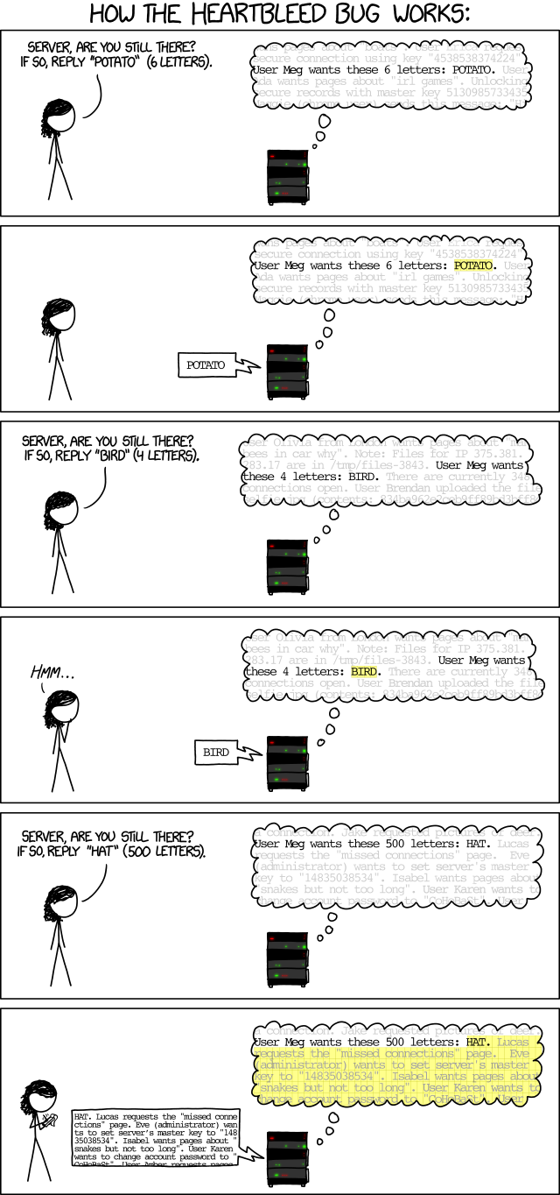
Heartbleed explained
Image from xkcd.com

Slide 57
Formatted I/O
C’s printf family supports formatted I/O
Format specifiers
Position in string indicates stack argument to print
Kind of specifier indicates type of the argument
%s = string, %d= integer etc.
void print_record(int age, char *name)
{
printf(“Name: %s\tAge: %d\n”, name, age);
}

Slide 58
Protection against Buffer Overflows
Countermeasures
Secure Coding
Stack canaries
Non-Executable Stack
Address Space Layout Randomization (ASLR)

Slide 59
Defense Strategies
Avoid the buffer overflow entirely
Secure coding
Code Review
Static Analysis
Testing
Make the buffer overflow harder to exploit
Examine necessary steps for exploitation, make one or more of them difficult, or impossible

Slide 60
Secure Coding
void func (char *arg1)
{
char buffer[4];
strcpy(buffer, arg1);
}
strcpy operates on null terminated strings and performs no bounds checking
void func (char *arg1)
{
char buffer[4];
strlcpy(buffer, arg1,sizeof(buffer));
}

Slide 61
Unsafe C functions
gets() – reads input without checking. Don’t use it!
strcpy() – strcpy(dest, src) copies from src to dest
If src longer than dest buffer, keeps writing!
strcat() – strcat(dest, src) appends src to dest
If src + data in dest longer than dest buffer, keeps writing!
printf() – prints arguments as specified by format specifiers
If there are no arguments matching format specifiers keeps printing!

Slide 62
Alternative Safe Functions
strcpy() → strlcpy()
strncpy() → strlcpy()
strcat() → strlcat()
strncat()→ strlcat()
sprintf()→ snprintf()
gets() → fgets()

Slide 63
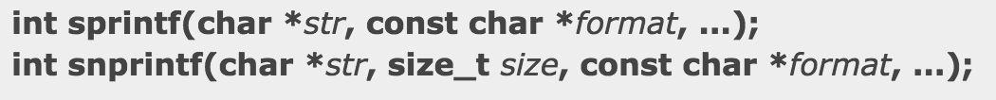
Why are they safer?
C library functions such as strcpy (), strcat (), sprintf () and vsprintf () operate on null terminated strings and perform no bounds checking.
gets () is another function that reads input (into a buffer) from stdin until a terminating newline or EOF (End of File) is found.
The scanf () family of functions also may result in buffer overflows. Using strncpy(), strncat(), snprintf(), and fgets() all mitigate this problem by specifying the expected input.

Slide 64

Secure Coding
The best defense is use C functions that support bounds checking
but there are many C/C++ programmers and some are bound to forget
➔ Are there any system defenses that can help?

Slide 65
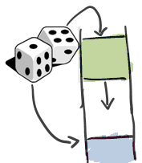


Automatic Techniques
A variety of tricks in combination
Non-Executable Stacks
Canaries
ASLR

Slide 66
Stack Canaries
Goal: make sure we detect overflow of return address
The idea:
The functions' prologues insert a canary on the stack
The canary is a value inserted between the return address and local variables
Types of canaries:
Terminator
Random
Random XOR
The epilogue checks if the canary has been altered

Slide 67
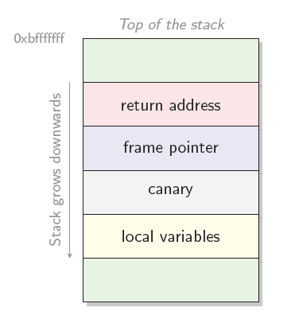
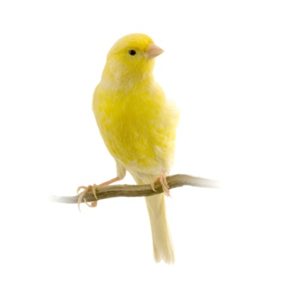

Stack Canaries

Slide 68
Stack Canaries Values
Terminator canaries (CR, LF, NUL (i.e., 0), -1)
Leverages the fact that scanf etc. don’t allow these
Random canaries
Write a new random value @ each process start
Save the real value somewhere in memory
Must write-protect the stored value
Random XOR canaries
Same as random canaries but store canary XOR some control info, instead

Slide 69
Stack Canaries

Slide 70
Stack Canaries Attacks
An attacker may attempt to guess the value of the canary
Include the value in the injection vector used to overflow the buffer
Overwrite the value of the canary with the original value

Slide 71
Stack Canaries Implementations
Stackguard
ProPolice gcc’ stack smashing protector
Microsoft’s Visual C++ .NET

Slide 72
Stack Canaries Limitations
Useful to protect against buffer overflows that overwrites the return address
Do not protect the program from exploits that modify variables, object pointers, or function pointers
Do not protect against heap buffer overflows

Slide 73
Non-Executable Stacks
Goal: Prevent an attacker to execute his code
Idea: mark data memory (stack, heap, ...) as non-executable
Limitations
Prevent only execution of malicious code on the stack
Do not prevent buffer overflow attacks that modify return address, variable, object pointers, and function pointers
Do not prevent buffer overflow in the heap or data segments of the memory of the program
May affect performance

Slide 74
Address Space Layout Randomisation
Goal: Prevent the attacker from guessing the memory address of his code
Idea:
Randomize the address in memory of all code, heap, stack, global variables, stack variables, arrays, etc
Buffer overflow: the attacker does not know the address of the shellcode
Implementations: Linux kernel > 2.6.11, Windows Vista, . . .

Slide 75
ASLR Limitations
Do not prevent the return address on the stack from being overwritten
Do not prevent attacks where the attacker can read the software memory
Do not prevent attacks where the attacker overwrites data
Subject to brute force attack against the number of possible memory layout shuffles (32 bits OS)

